Slide 1
WEB PORTAL FOR ORGANIC PRODUCTS
PRESENTED BY:
ASWINI T(211419104031)
BHARGHAVI J(211419104041)
BATCH NO : A7
GUIDE NAME : Dr . K . SANGEETHA ME.,Ph.D.,

Slide 2
ABSTRACT
The objective of the organic web portal is to spread awareness about the benefits of organic farming and motivate farmers for organic farming.
Its marketing division is going to help farmers sell their organic products.
Organic foods helps in keeping agricultural production at a sustainable level . It reduces the cost of agricultural production and also improves the soil health.
It ensures optimum utilization of natural resources for short-term benefit and helps in conserving them for future generation.
The platform is committed to provide organic food for healthy living to consumers.

Slide 3
INTRODUCTION
Organic foods are foods and drinks produced by methods complying with the standards of organic farming.
Standards vary worldwide, but organic farming features practices that cycle resources, promote ecological balance, and conserve biodiversity.
Organizations regulating organic products may restrict the use of certain pesticides and fertilizers in the farming methods used to produce such products.
Organic foods typically are not processed using irradiation, industrial solvents, or synthetic food additives.
This web portal provides a platform where the people can buy organic products for their healthy life.

Slide 4
LITERATURE SURVEY
TITLE | AUTHOR | YEAR | DESCRIPTION | MERITS | DEMERITS | METHODOLOGIES
A community-based hybrid blockchain architecture for the organic food supply chain | Thanushya Thanujan; Chathura Rajapakse; Dilani Wickramaarachchi | 2021 | Presents a novel blockchain architecture to incorporate community-level trust into the organic food supply chain by hybridizing PoA and FBA consensus protocols. | Presents a qualitative analysis on the proposed architecture based on expert opinions | Participatory guarantee systems are still prone to frauds and have limitations in scalability as well | Bockchain Technlogy
Predictive Analytics Platform for Organic Cultivation Management | R.M.S.M. Rathnayake; E.W.L.M.B. Ekanayake; K.A.I.P. Kahandawala; W.G.S.C | 2019 | Presents design and development of a software platform for supporting sustainability of organic agriculture system | Capable of predicting organic harvests, prices and provide decision support on crop selection for upcoming cultivations | The accuracy of the prediction system can differ from is high | Machine learning, optimization techniques, blockchain technology

Slide 5
TITLE | AUTHOR | YEAR | DESCRIPTION | MERITS | DEMERITS | METHODOLOGIES
A Blockchain-based decentralized system to ensure the transparency of organic food supply chain | B. M. A. L. Basnayake; C. Rajapakse | 2019 | Prepares transparent and efficient architecture for food certification | A token-based mechanism was used to indicate the farmers ’ reputation with their products. | Ethereum Geth client should be used but with low computational power and storage limitations, it is not recommended. | Blockchain concept and other technologies
Marketing of Organic Food Products at Madurai City | P Shandini; N Ramani | 2021 | Reveals the percentage consumption of organic food products | Provides suggestions to implement the various marketing strategies adopted by the retailers | The geographical focus of the study was limited | Statistical methods and other techniques

Slide 6
TITLE | AUTHOR | YEAR | DESCRIPTION | MERITS | DEMERITS | METHODOLOGIES
The importance of websites for organic agri-food producers | Domingo Fernández-Uclés ,Enrique Bernal-Jurado ,Adoración Mozas-Moral &Miguel Jesús Medina-Virue | 2019 | Reveal differences between organic and conventional olive oil producers regarding website adoption and use. Also reveal the relevance of being an organic producer and having a capitalist or cooperative company structure. | Contribute to a better understanding of the organic food market | The study focused only on a specific sector, namely the organic olive oil sector | Statistical methods and other techniques

Slide 7
PROBLEM STATEMENT
Many ecological and societal impacts of excessive use of harmful chemical fertilizers and pesticides in growing our food are apparent today
Drastic loss of soil nutrients has caused the land to become infertile, loss of groundwater has become a common occurrence in agricultural areas, loss of multiple distinct indigenous crops, excessive presence of pesticides residues in food and environment.
Farmers who understand these impacts on the environment as well as on our health have switched to the traditional way of natural farming.
High prices due to multiple middle persons involved in supply chain and trust issues created by brands selling inorganic products with organic labels discourages consumers to buy organic food.
Our mission is to provide a trustworthy platform to enable organic farmers to sell their produce directly to consumers and to provide our conscious consumers a convenient access to naturally grown unadulterated food at fair prices.

Slide 8
EXISTING SYSTEM
The existing portal for organic products provides a platform where we can buy organic foods and drinks.
The customers have variety of organic products all over the world and can select products according to their needs and wants.
The sellers who are farmers are able to manage the availability of their products and are also able to observe the orders made by customers.
The system does not provide any proof for the reliability that the products are all organic.
The system does not provide platforms for farmers to clear their doubts regarding organic farming and about diseases of the plants.

Slide 9
PROPOSED SYSTEM
The Proposed system provides the platform for the customers to buy the organic foods according to their needs and location where the products are verified for trustworthiness by certain certifications.
The farmers can not only manage their orders and availability of products but can also avail their organic certificates for credibility.
It also supplies the contacts of experts who are interested in teaching technologies and issues related to organic farming.
The people who are skilled and mastered in organic farming can register them as experts and provide their ideas for the farmers to contribute towards food sovereignty.
The system not only provides platform for marketing organic products but also the ways by which organic farming can be developed for the welfare for present and future generations.

Slide 10
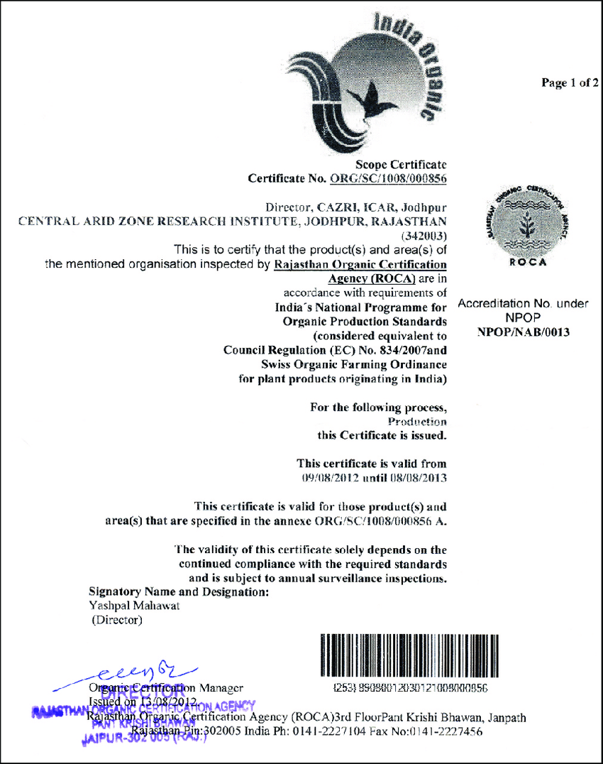
Sellers can directly upload their certificates for verification

Slide 11
Sellers can also provide link for their certificates
EXAMPLE:
https://jaivikbharat.fssai.gov.in/inner.php?state_id=&search-box=GREENEERS+AGRO+PRODUCTS+INDIA+PRIVATE+LIMITED&data-id-company=GREENEERS+AGRO+PRODUCTS+INDIA+PRIVATE+LIMITED&CompanySearch=

Slide 12
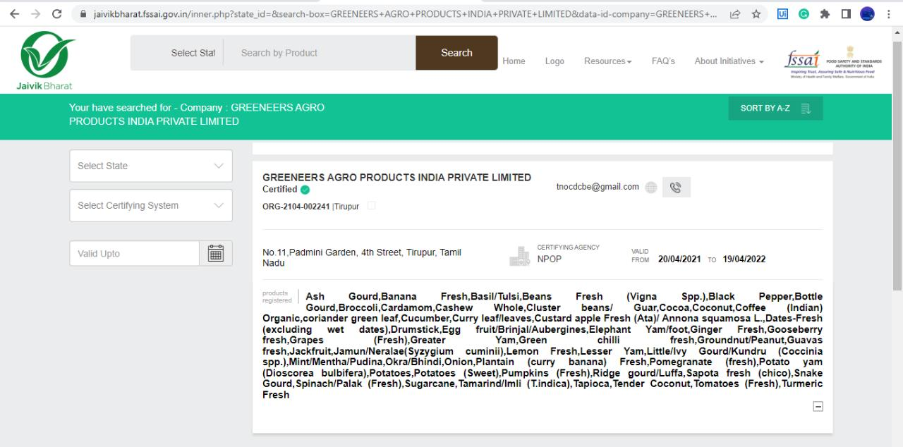
Using the above link we can verify the seller’s certificate

Slide 13
REQUIREMENTS
HARDWARE
Computer /Laptop/Mobile
SOFTWARE
XAMPP
Sublime Text
MySQL Database

Slide 14
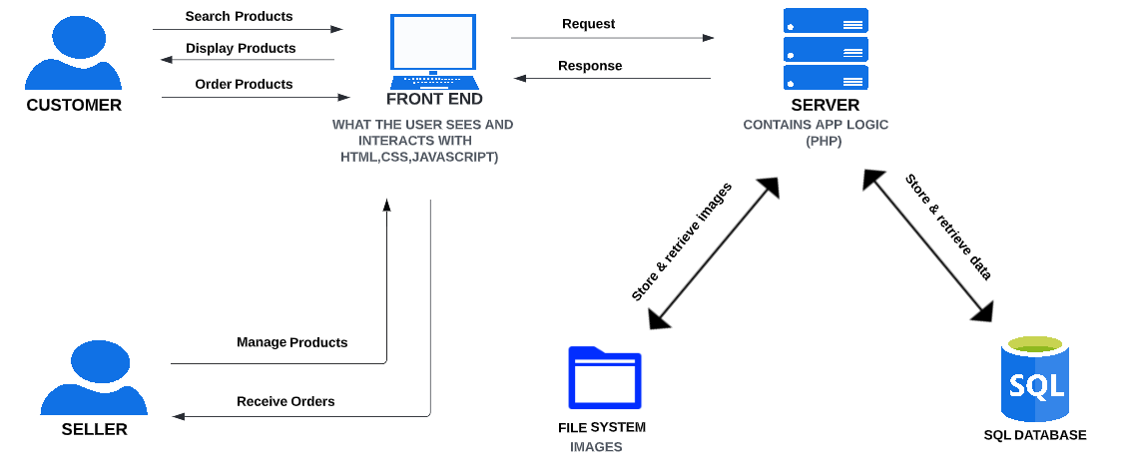
SYSTEM ARCHITECTURE

Slide 15
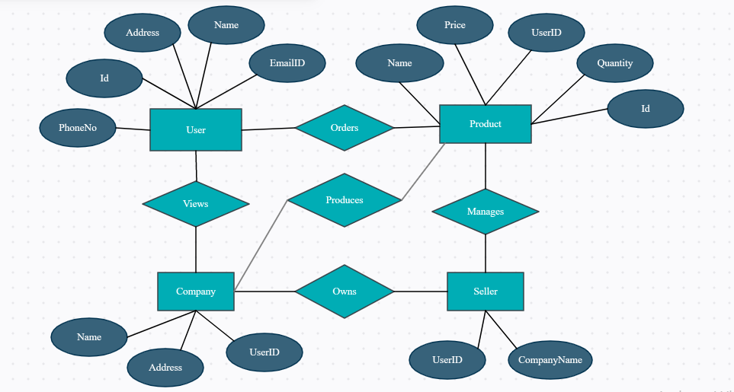
SYSTEM DESIGN
ER DIAGRAM

Slide 16
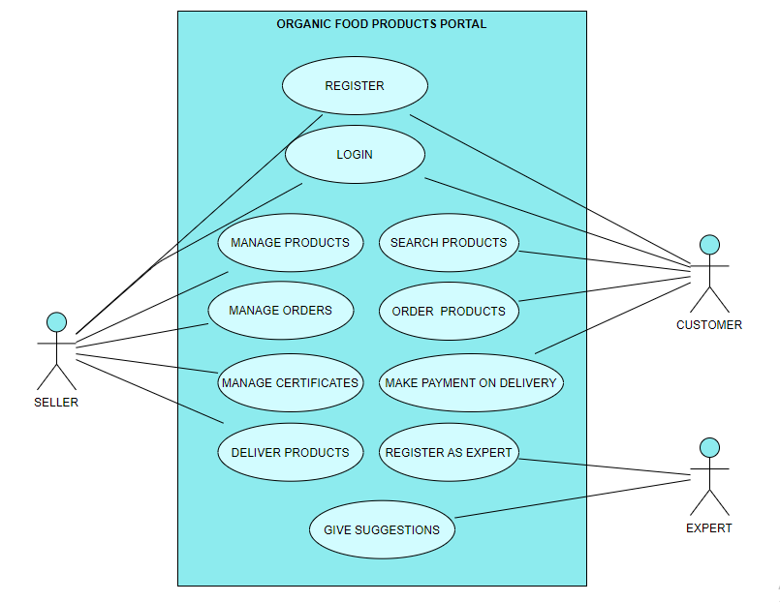
USECASE DIAGRAM

Slide 17
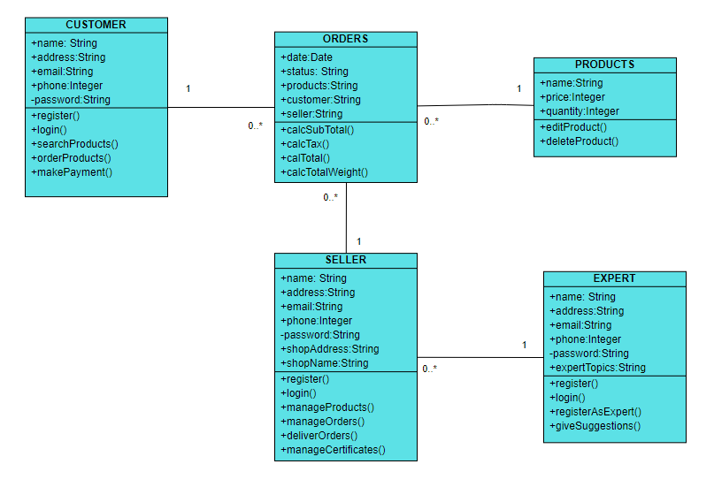
CLASS DIAGRAM

Slide 18
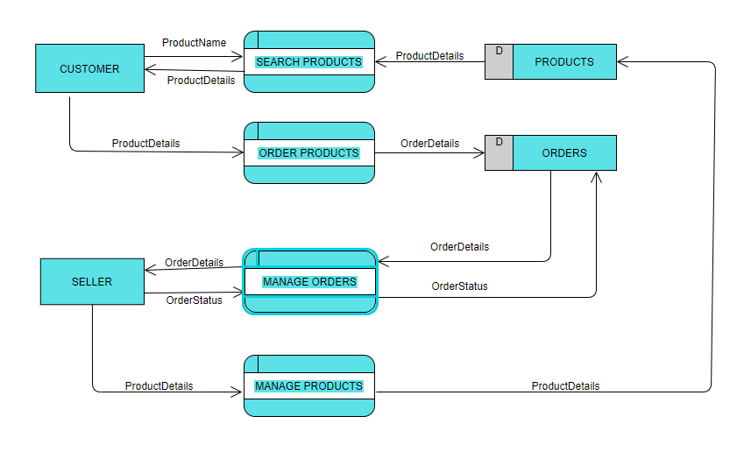
DATAFLOW DIAGRAM

Slide 19
MODULES
CONNECTION
‘Connection’ module is used to establish connection between Backend Program and Database.
LOGIN
‘Login’ module is used for users to login into the Portal.
REGISTER
‘Register’ module is used for users to register in order to use the Portal.
LOGOUT
‘Logout’ module is used for users to logout from the Portal.

Slide 20
INDEX
‘Index’ module displays the home page of the Portal which contain options like Login,Register,BuyProducts,SellProducts etc
SELL PRODUCTS
‘Sell Products’ module displays the option to become a seller, if the user is not a seller .If the user is a seller ,it display the list of orders received by that user,along with other options like ManageCertificate, ManageCompanydetails, ManageProducts etc.
BECOME SELLER
‘Become seller’ module collects the details such as Company Name ,Company PhoneNo ,Company EmailID, Address of Company etc from the user who wants to become a seller. The collected data is then stored in the database.
MANAGE PRODUCTS
‘Manage Products’ module allows seller to add a product,edit a product’s name ,photo ,price etc and delete a product.

Slide 21
ORDER DETAILS
When a seller clicks on an order from the orders list, ‘Order details’ module displays the product details of that order such as Product name, Quantity ordered, Date of order etc and the customer’s details such as Customer name, Address, Phone number, EmailID etc.It also gives options to change the status of the order such as Ordered, Transported, Delivered.
BUY PRODUCT
‘Buy Product’ module is used for users to search for products using Product name,Company name and Place.
VIEW COMPANY PRODUCT DETAILS
‘View company product details’ module displays the product and its company details to the customer ,after searching for product.
ORDER PRODUCTS
‘Order products’ module displays the product details to the customer and gets the quantity entered by the customer for that product and stores the order details in the database.

Slide 22
PERFORMANCE EVALUATION
S. No | Test Case | Test Steps | Test Results
1 | Verify Login functionalities with the correct condition | Enter mail id: abc@sample.com Enter password: xyz | Redirect to Home page
2 | Verify Login functionalities with the wrong condition | Enter mail id: abc@sample.com Enter password: Empty | Please fill out this field
3 | Verify search result with available product name | Enter Product name : Tomato | Displays Product Name,Price, Company Name,Location along with link to view the product and company details.
4 | Verify search result with unavailable product name | Enter Product name : Rice | No result found for : "Rice"

Slide 23
PERFORMANCE EVALUATION
S. No | Test Case | Test Steps | Test Results
5 | Verify the result when the seller clicks ‘Sell Products’ option | Click the ‘Sell Products’ option | Order details are displayed
6 | Verify whether the Product details are updated after editing them. | Enter Price : 100 | Price updated as ‘100’

Slide 24
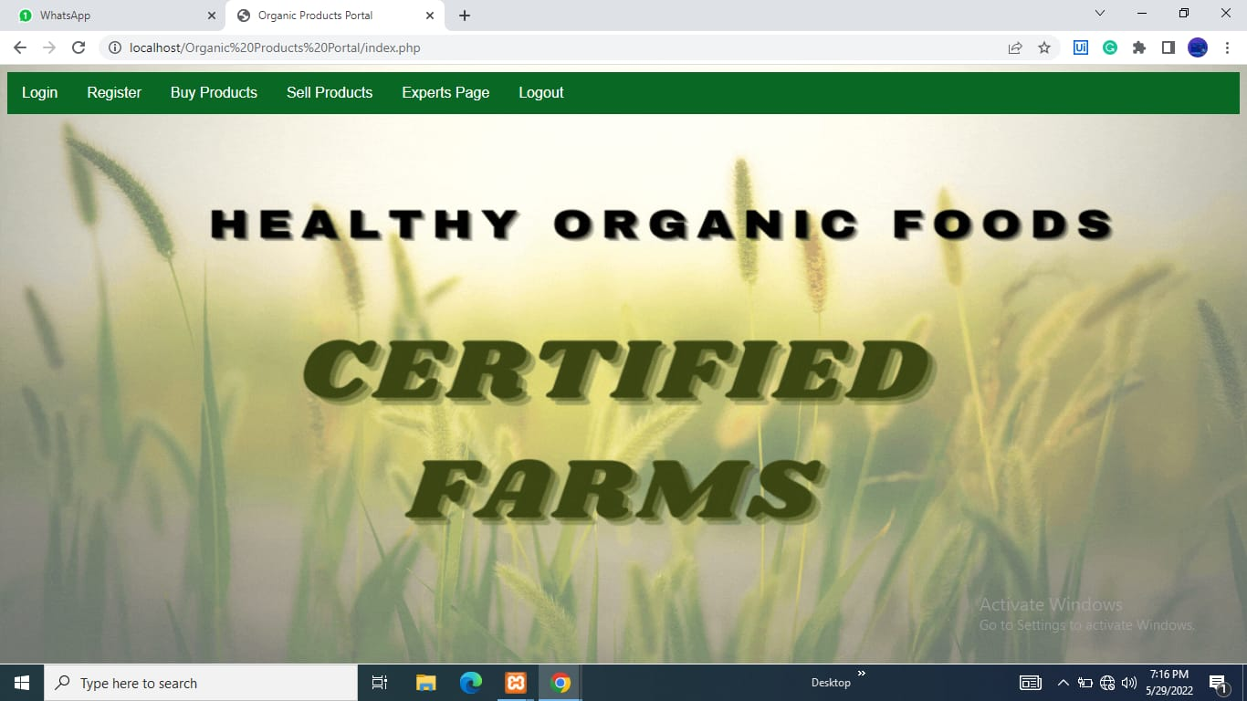
SCREENSHOTS

Slide 25
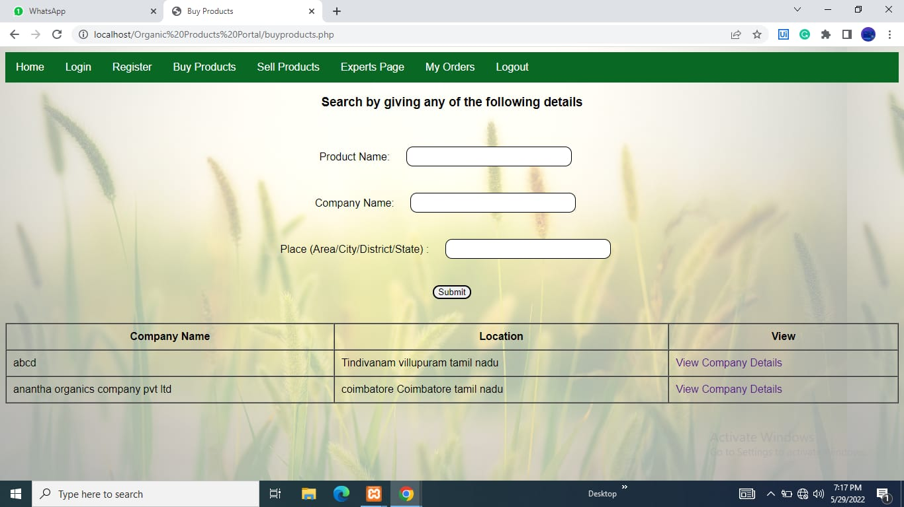

Slide 26
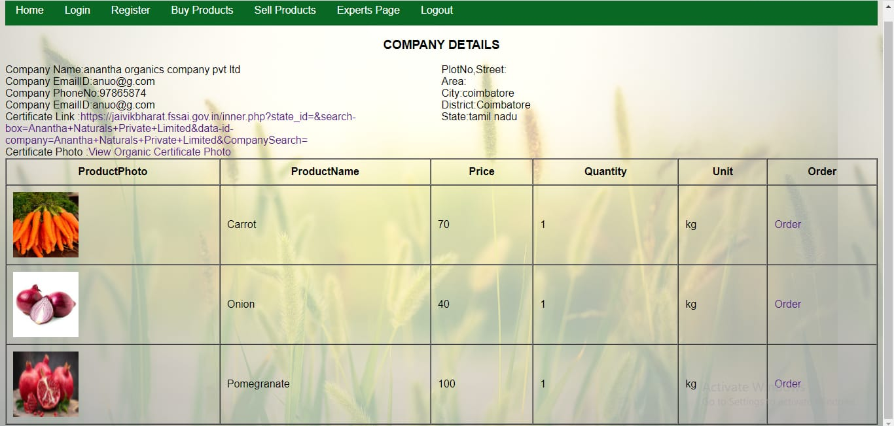

Slide 27
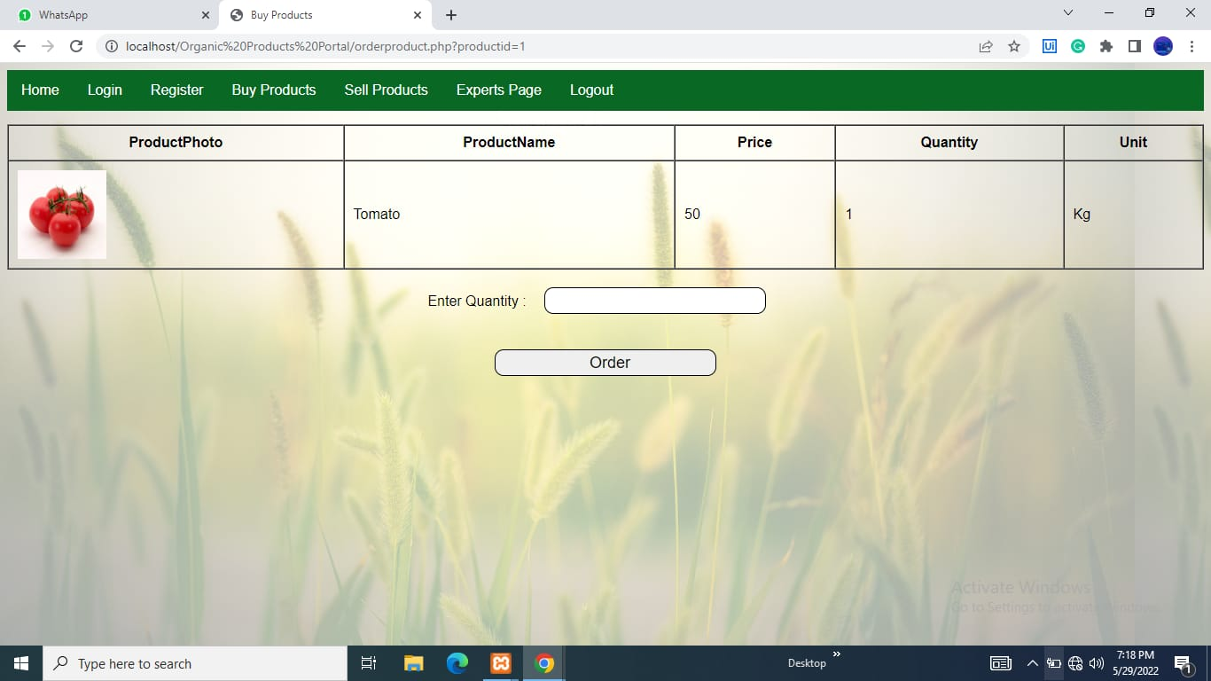

Slide 28
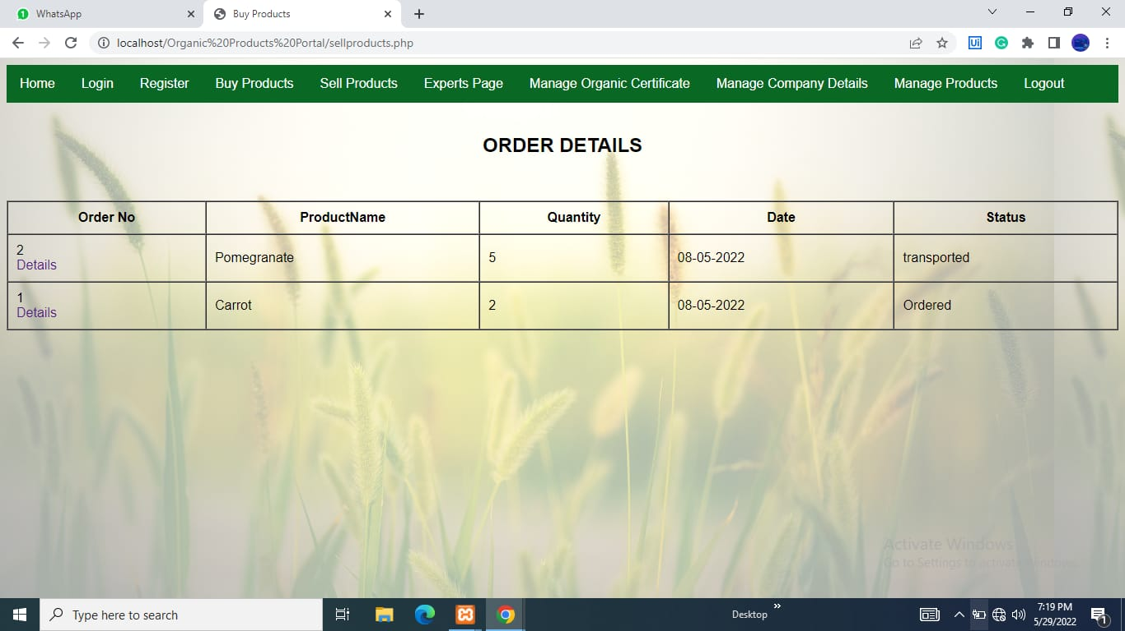

Slide 29


Slide 30
CONCLUSION
Organic farming on small farms leads to an increase in food production and to greater benefits for the ecosystem by improving soil organic matter, reducing erosion and increasing biodiversity.
Organic farming yields more nutritious and safe food.
The popularity of organic food is growing dramatically as consumer seeks the organic foods that are thought to be healthier and safer.
Thus, organic food perhaps ensures food safety from farm to plate.

Slide 31
REFERENCE
1. "Sri Lankan Organic Products Certification|Organic Agricultural Product Standards", [online] Available: http://www.srilankabusiness.com/organic/organic-certification-in-sri-lanka.html.
2. Ragavan, N., Dr., & Mageh, R., Dr. (2012). A Study on Consumers’ Purchase Intentions towards Organic Products. PARIPEX Paripex - Indian Journal of Research,2(1), 111-114. doi:10.15373/ 22501991/jan2013/41
3."Organic Industry Survey in U.S", May 2016, [online] Available: https://www.ota.com/news/press-releases/19031

